Slide 1
Women in the Bible: The Healed Woman and me
“Your word is lamp for my feet and a light for my path.”
Psalm 119:105
Transformation
By faith
14
LESSON

Slide 2
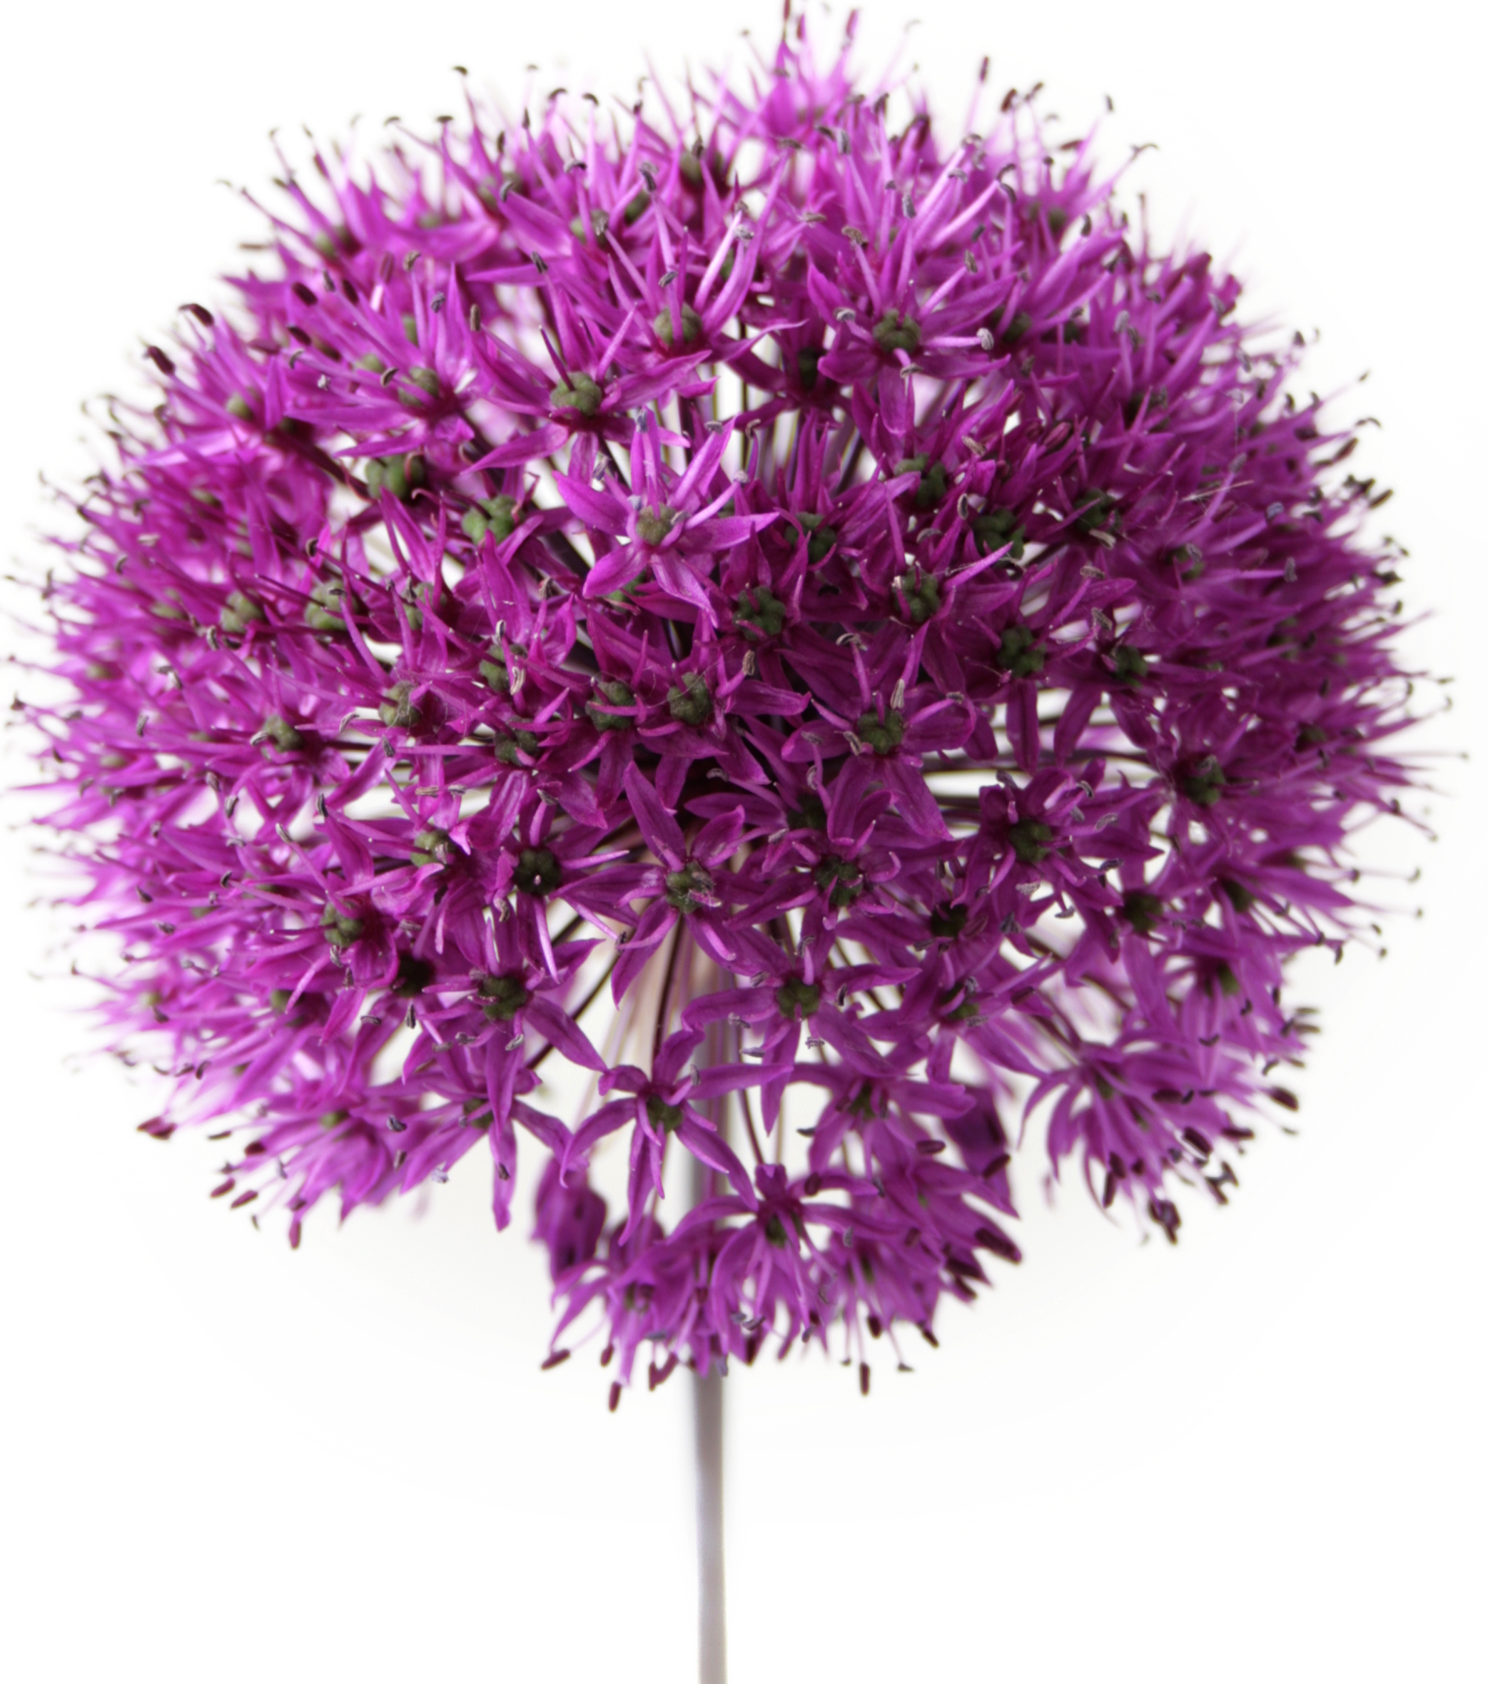
The Healed Woman
A Beautiful Story About a Woman Whose Name is Unknown
Key Scripture: Luke 1 and 2
Introduction
The woman in this story had suffered for 12 years, not just from disease but from isolation. In those days she would be a virtual outcast; anyone or anything she touched would be considered ceremonially unclean. In this context touch becomes a significant symbol.

Slide 3
The Healed Woman
A Beautiful Story About a Woman Whose Name is Unknown
This is a story of healing. God promises to heal us. For some, healing may not take place here on earth. And ultimately, true healing—the healing that will cure even those who don’t suffer from physical ailments—will take place not here but in heaven.

Slide 4
The Healed Woman
A Beautiful Story About a Woman Whose Name is Unknown
Discover
* Her Failure to Find Help
* Her Faith and Persistence
* Her Joy

Slide 5
The Healed Woman
A Beautiful Story About a Woman Whose Name is Unknown
Going Deeper
What was the past experience of this woman as she sought help? (Mark 5:25-26, Matthew 9:20, Luke 8:43)
2. How long had she been ill? (Matthew 9:20, Mark 5:25, Luke 8:43)
3. Her hope for healing had faded, and she now felt she had only one hope. What was this? (Matthew 9:21)

Slide 6
The Healed Woman
A Beautiful Story About a Woman Whose Name is Unknown
4. The crowd was pressing around Jesus so that it was difficult to reach Him? What did the woman do? (Mark 5:27-28, Luke 8:44)
5. What was Jesus’ immediate response? (Mark 5:30, Luke 8:45)
6. How did the disciples react to this question? (Mark 5:31, Luke 8:45)

Slide 7
The Healed Woman
A Beautiful Story About a Woman Whose Name is Unknown
7. How did her physical condition change after she touched the hem of Jesus’ garment? (Luke 8:44)
8. Bowing before the Master, she confessed that she was the one who had touched Him. How do you think she felt as she did this? (Mark 5:33)
9. With what words of blessing did Jesus pronounce her healed? (Matthew 9:22, Mark 5:34, Luke 8:48)

Slide 8
The Healed Woman
A Beautiful Story About a Woman Whose Name is Unknown
Words for Today
10. When do you think it is appropriate for us to come just as boldly to Jesus to ask for healing of our infirmities today, and when might it not be appropriate? Why?
11. Do we sometimes approach Him hesitantly, perhaps in embarrassment or fear? What might be possible reasons? Has this happened to you? How may we dispel these feelings?

Slide 9
The Healed Woman
A Beautiful Story About a Woman Whose Name is Unknown
Questions for Discussion
How do you think Jesus knew someone had touched Him? What made this touch different from others?
2. Why do you think this woman was afraid to admit she was the one in the crowd who had touched Jesus and been healed?

Slide 10
The Healed Woman
A Beautiful Story About a Woman Whose Name is Unknown
Words of Wisdom
This woman must have been feeling very desperate. Having given up on the doctors of the day, she sought help from the One who had healed so many. Not wanting to draw attention to herself, she thought to reach out to Him in a quiet and unobtrusive manner. Imagine her embarrassment at having the attention of everyone drawn to her.

Slide 11
The Healed Woman
A Beautiful Story About a Woman Whose Name is Unknown
In humility and thankfulness she admitted to being the one who had drawn healing power from touching Jesus’ garment. Her life was transformed by her faith. Christ understood the longing of her heart just as He understands the longing of our hearts today.

Slide 12
The Healed Woman
A Beautiful Story About a Woman Whose Name is Unknown
My Prayer for Today
Today, dear God, we also seek healing from the infirmities of life that we have to endure. Whether they are emotional, physical, or spiritual ailments, we ask that you will remove them from us, and let us walk in newness of health. Thank You for the precious promises of healing You have given us.

Slide 13
The Healed Woman
A Beautiful Story About a Woman Whose Name is Unknown
Sharing
Each one of us knows those in our circle of friends and acquaintances who are in need of help when they are ill. We might take them to a doctor’s appointment; bring a loaf of bread or a main dish; help with laundry, house cleaning, or grocery shopping; or even care for a pet. Sometimes just spending time with them or giving a hug is the most welcome gift we can bestow. A gift of our time speaks volumes.
What are some specific ways I could help the sick, especially those with a chronic illness?

